Slide 1
Computing – Year 3
Knowledge organisers

Slide 2
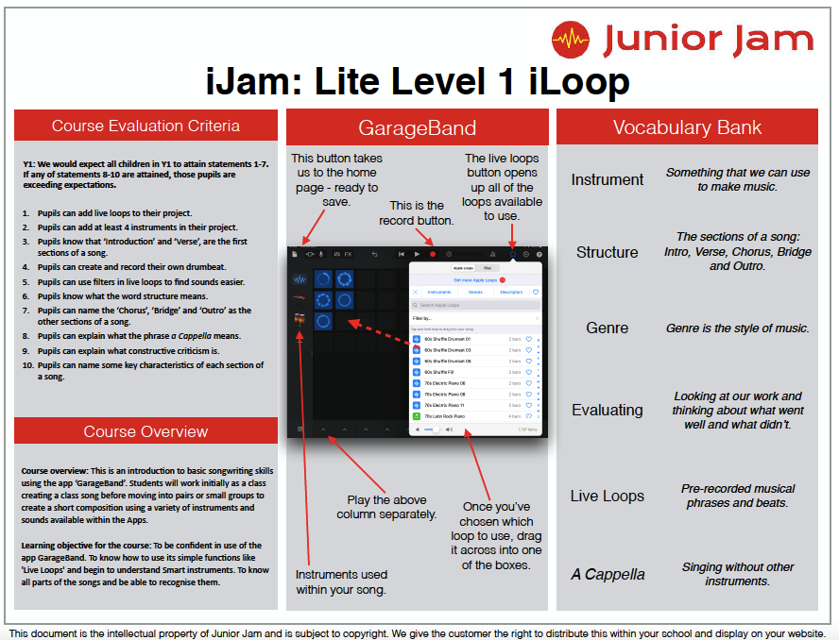
Year 3
Autumn Term 1
iJam

Slide 3
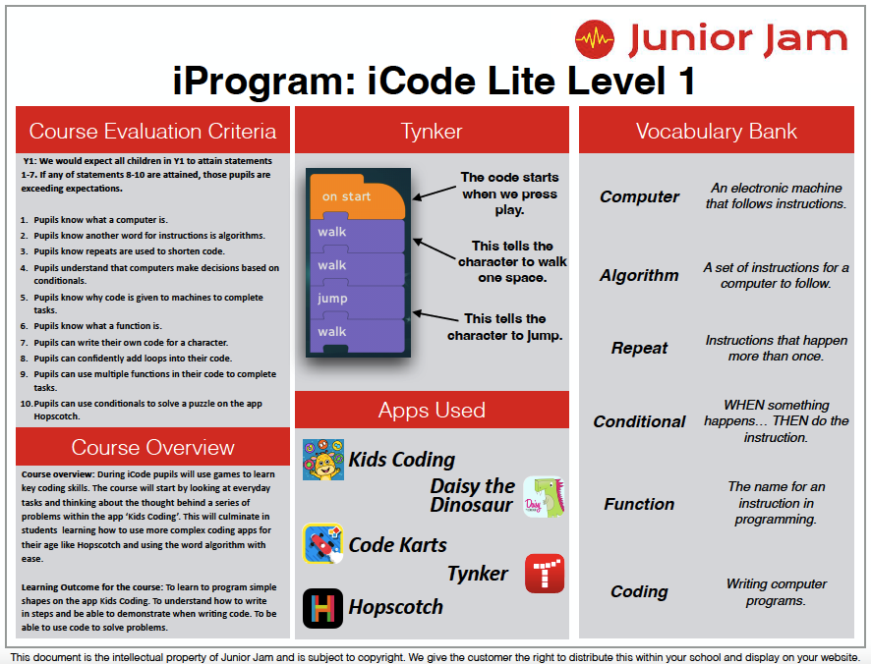
Year 3
Autumn Term 2
iCode

Slide 4
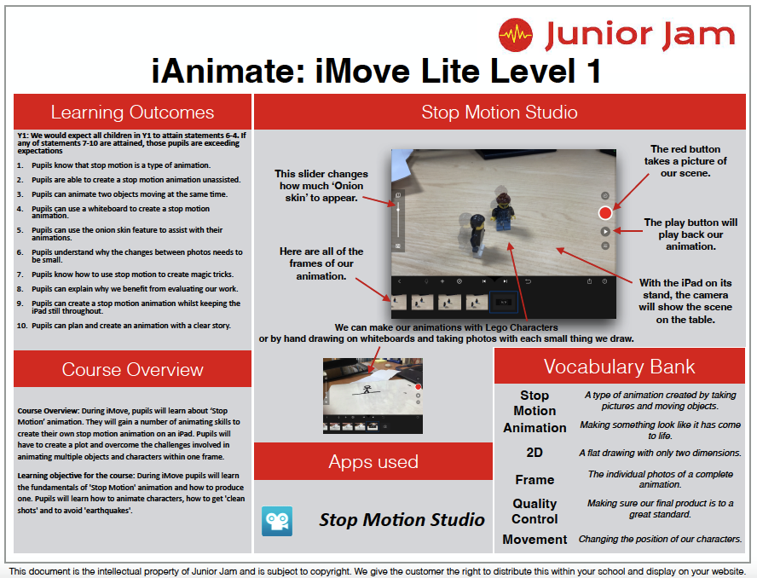
Year 3
Spring Term 1
iJam

Slide 5
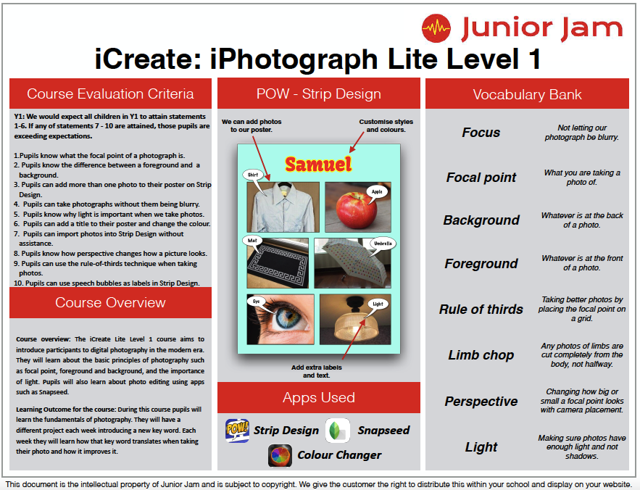
Year 3
Spring Term 2
iCreate

Slide 6
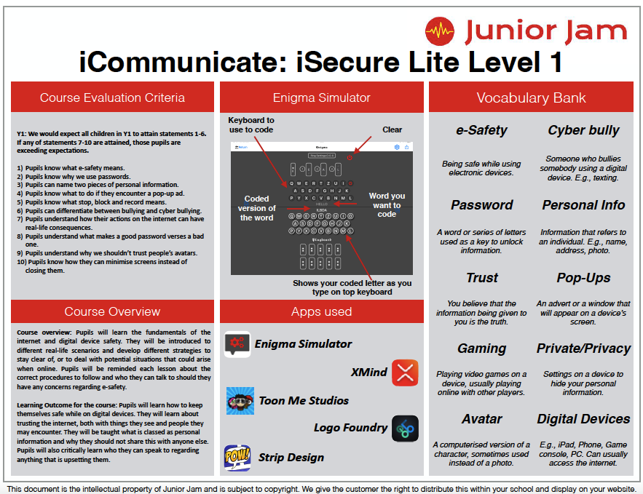
Year 3
Summer Term 1
iCommunicate

Slide 7
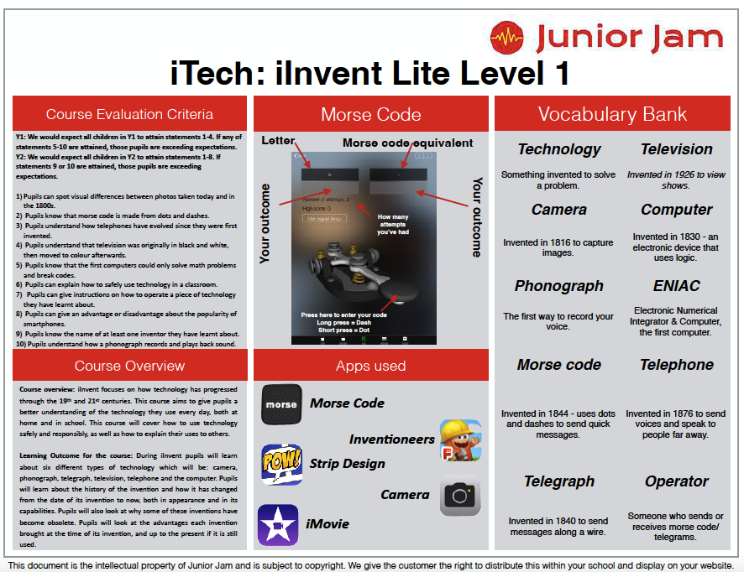
Year 3
Summer Term 2
iTech

