Slide 1
GEOGRAPHY – Year 3
Knowledge organisers

Slide 2
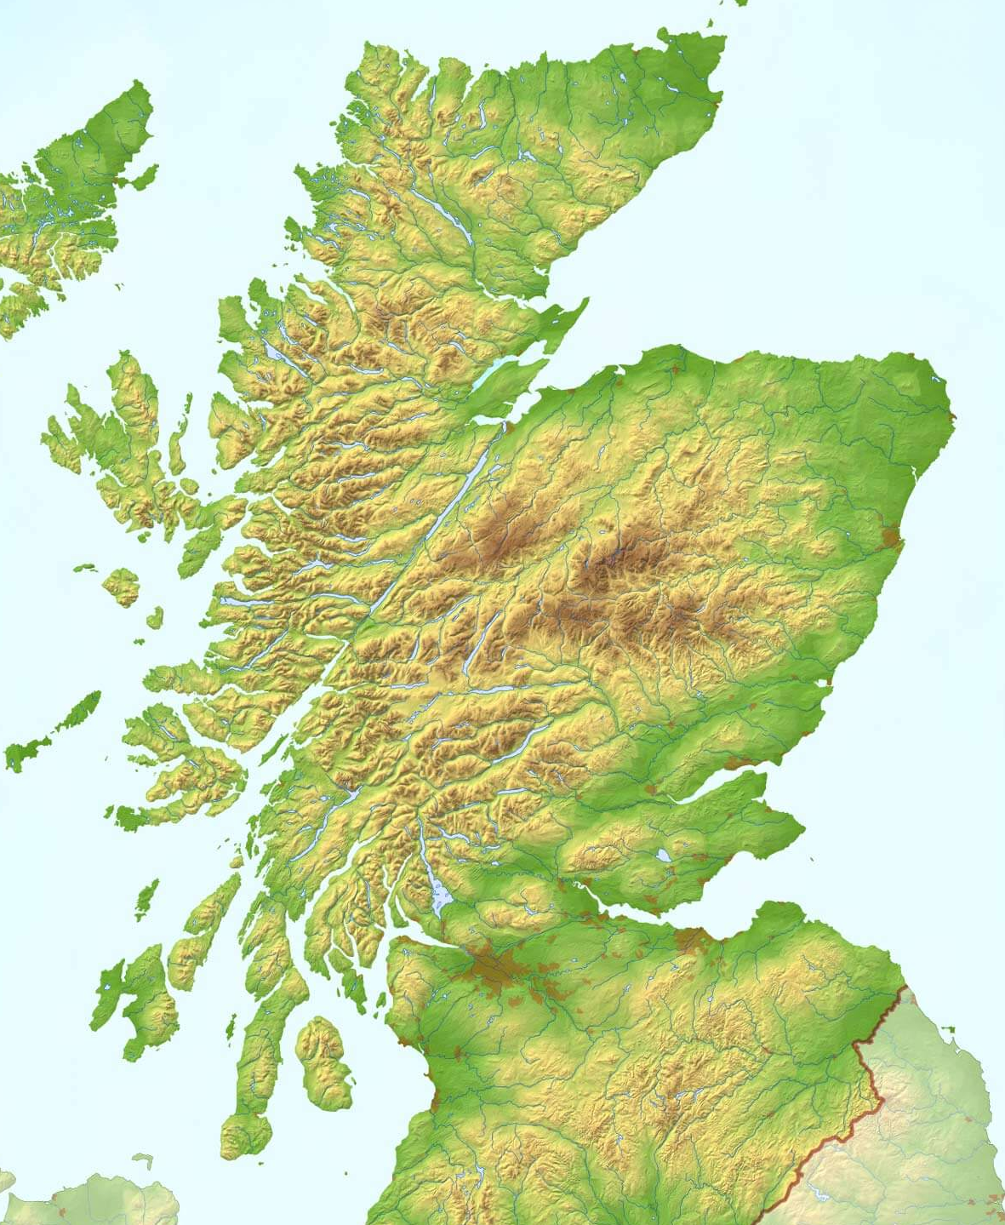
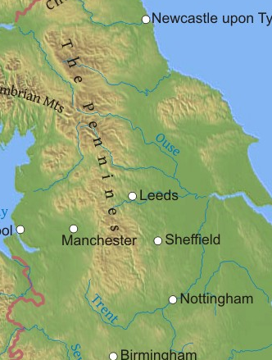
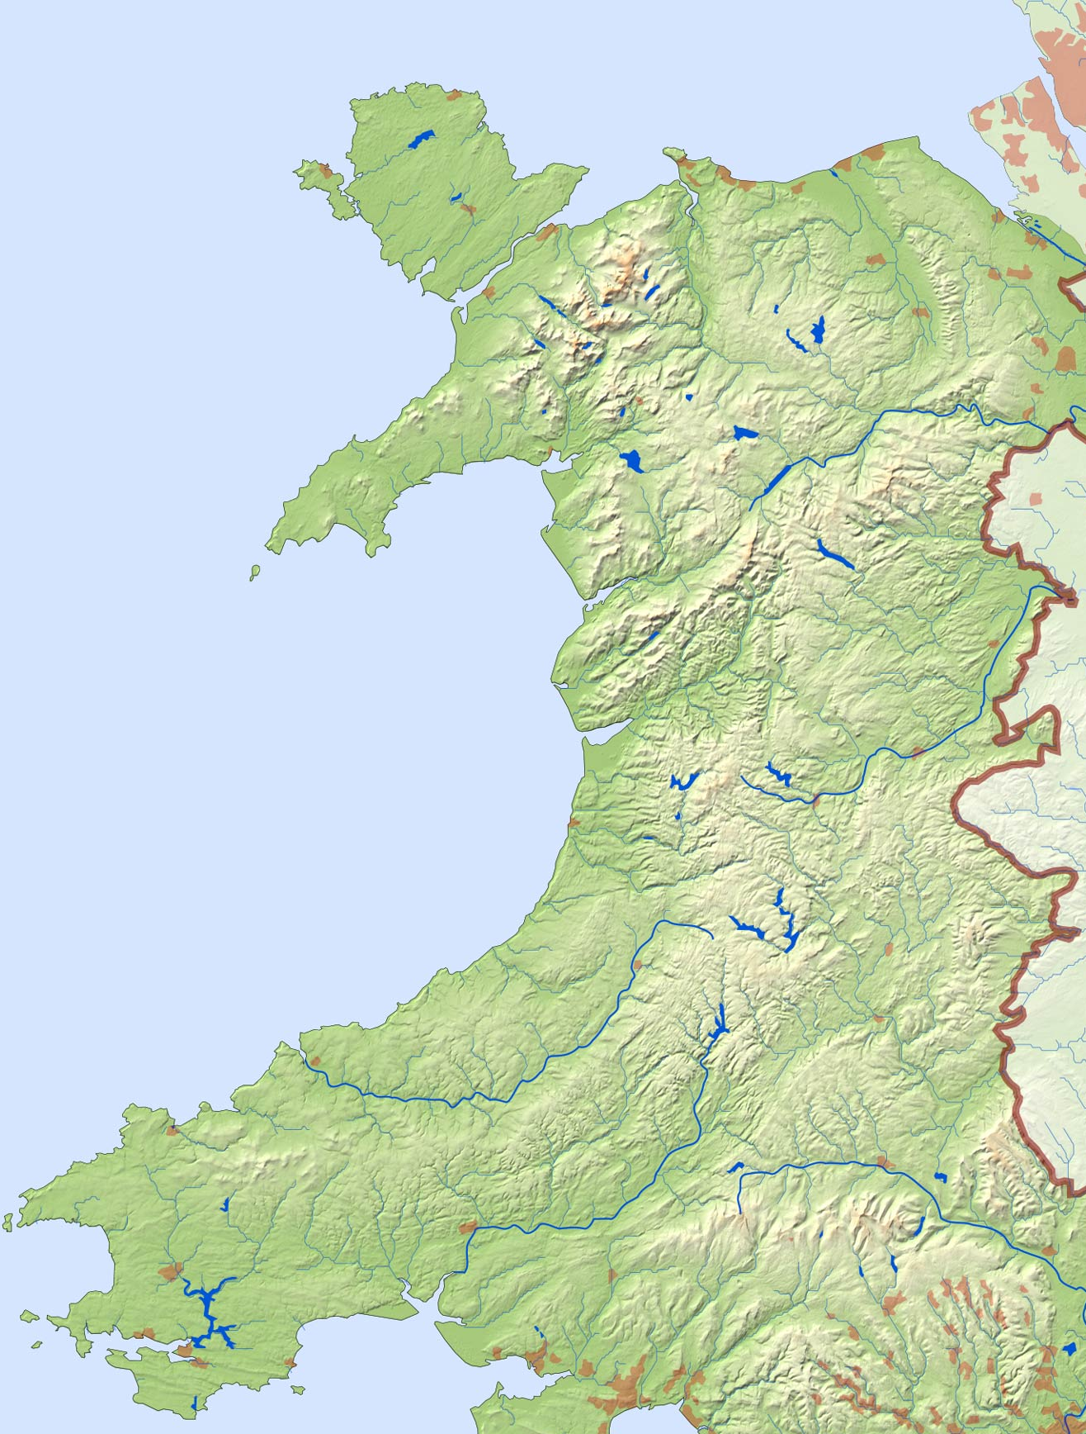
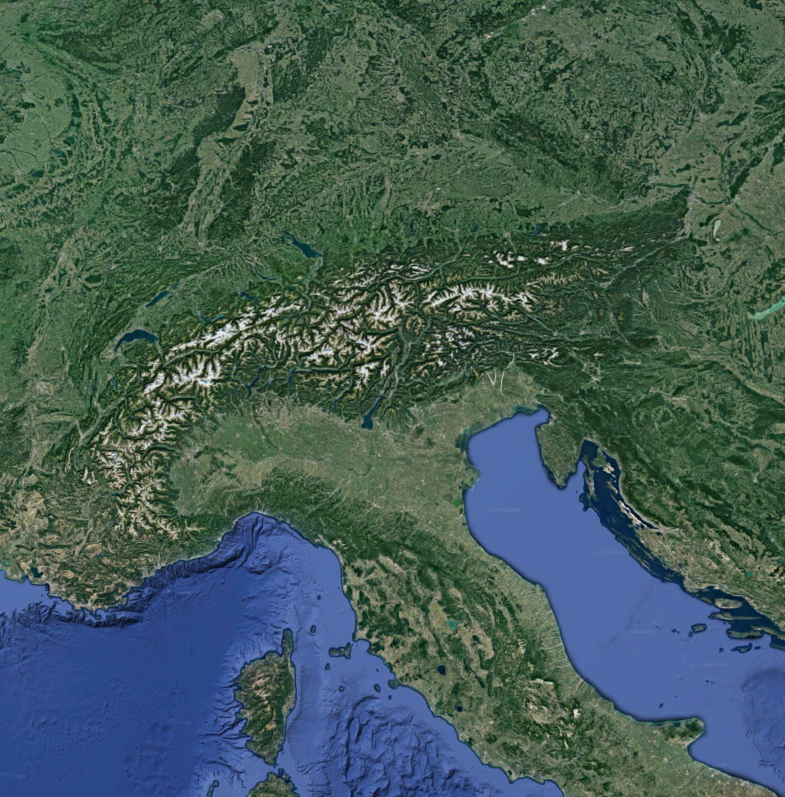
Year 3 Spring Term The UK/Mountains
Locational Knowledge
The children will name and locate counties and cities of the United Kingdom, geographical regions and their identifying human and physical characteristics, key topographical features (including hills, mountains, coasts and rivers).
Geographical Skills & Fieldwork
Use maps, atlases, globes and digital/computer mapping to locate countries and describe features studied
Use the eight points of a compass and symbols and keys (including the use of Ordnance Survey maps) to build knowledge of the United Kingdom
Use fieldwork to observe, measure, record and present the human and physical features in the local area using a range of methods, including sketch maps, plans and graphs, and digital technologies
Place Knowledge
Children will understand geographical similarities and differences through the study of physical geography of a mountainous region of the United Kingdom and a mountainous region within Europe.
Scottish Highlands
The Pennines
Snowdonia, Cambrian Mtns & Brecon Beacons
The French, Italian, Austrian and Swiss Alps

Slide 3
Year 3 Spring Term The UK/Mountains
Physical Geographical Features
The UK
Location of major cities – London, Edinburgh, Cardiff and Belfast
The Thames, the Aire
The North Sea, the English Channel, the Irish Sea, the Atlantic Ocean
Mountains
Find the height of a mountain on a map
Locate mountain ranges on a physical map
The Scottish Highlands
Snowdonia
The Pennines
The Lake District
Ben Nevis
Snowdon
Scafell Pike
The Alps
Mont Blanc
Human Geographical Features
The UK
The countries that make up the UK
Capital Cities of the countries of the UK – name and label them on a map.
Name the seas surrounding the UK and name some of the main rivers
Know what a county is and find West Yorkshire on a map
Find London on UK and main maps
Describe how the UK population has changed over time
Use 8 compass directions to find a location on a map
Mountains
Know the names of the highest peaks in Scotland, Wales and England and the closest mountains to Yeadon
Compare mountains of the UK to those in Continental Europe
Know different types of mountains and how they are formed
Key Vocabulary
Country
UK
England
Wales
Scotland
Northern Ireland
The Republic of Ireland
County
Yorkshire
Sea
Ocean
River
Mountain
Range
Highlands
Ben Nevis
Snowdonia
Snowdon
The Pennines
The Lake District
Scafell Pike
Europe
The Alps
Mont Blanc

