Slide 1
HISTORY – Year 3
Knowledge organisers

Slide 2
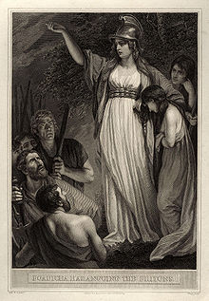
Year 3 Autumn Term
Stone Age to Iron Age
Historical Skills
Know and understand the history of Britain from the earliest times to modern history.
Know and understand how Britain has been influenced by the wider world.
Understand methods of historical enquiry, including how evidence is used to make historical claims.
Understand historical concepts such as continuity and change, similarity, difference and significance, using them to make connections, evaluate changes and create their own structured accounts.
Gain historical perspective by placing their growing knowledge into different contexts, understanding the connections between local, regional, national and international history.
Key Vocabulary
Archaeologist
Prehistoric
BC/AD
Artefacts
Neolithic
Stonehenge
Iron
Copper
Tin
Bronze
Alloy
Chronological
Spear
Weapons
Tools
Celt
Roman
Boudicca
Source
Evaluate
Invasion
Unit overview
The children will learn about:
When the Stone Age, Bronze Age and Iron Age were and how to understand the difference between BC and AD.
What Stone Age life was like, including what they wore, how they farmed and what they used.
Stone Age tools and their evolution over time.
Changes brought by the Bronze Age
How to use artefacts to evaluate change.
What life was like for Bronze Age children.
Who the Celts were, where they came from, where they lived and how they lived.
Boudicca and how we can use different sources to understand how she responded to the Roman invasion of Britain.
Famous people studied
Boudicca
Suetonius
Tacitus
Boudicca

Slide 3
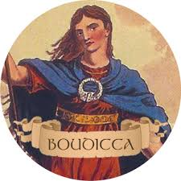
Spotlight: AD 61 Boudicca leads a rebellion against Roman forces in Britain
When her husband, King Prasutagus dies, Boudicca, Queen of the Iceni tribe is beaten and humiliated by Roman soldiers because she refuses to give up her lands. She raises an army of Celts and quickly takes 3 Roman cities. She then marches her army north and the Romans catch up with her. Her army is defeated. Boudicca poisons herself rather than face death at the hands of the Romans..

Slide 4
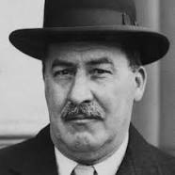
Year 3 Summer Term
Ancient Egypt
Historical Skills
Know and understand significant aspects of the history of the wider world.
Know and understand the nature of ancient civilisations.
Gain and deploy a historically grounded understanding of abstract terms such as ‘empire’ and ‘civilisation’.
Understand our knowledge of the past is constructed from a range of sources
Understand how evidence is used to make historical claims.
Key Vocabulary
Egypt
Nile
Pyramid
Tomb
Pharaoh
Hieroglyphics
Mummy
Ancient
Civilisation
Artefact
Religion
Archaeology
Tomb
Sarcophagus
Desert
Burial
Afterlife
Canopic
Scarab
Linen
Gold
Unit overview
The children will learn about:
When the Ancient Egyptians lived and how to understand the difference between BC and AD.
Where they lived and why most Egyptians still live near the Nile.
What they wore, how they farmed and how they lived.
What they believed in.
Who the Pharaohs were, particularly Tutankhamun and Cleopatra.
How they wrote.
How they preserved people as mummies.
How Tutankhamun’s tomb was discovered.
How we used the discovery of the Rosetta Stone to understand Egyptian writing.
Famous people studied
Tutankhamun
Cleopatra
Howard Carter
Howard
Carter

Slide 5
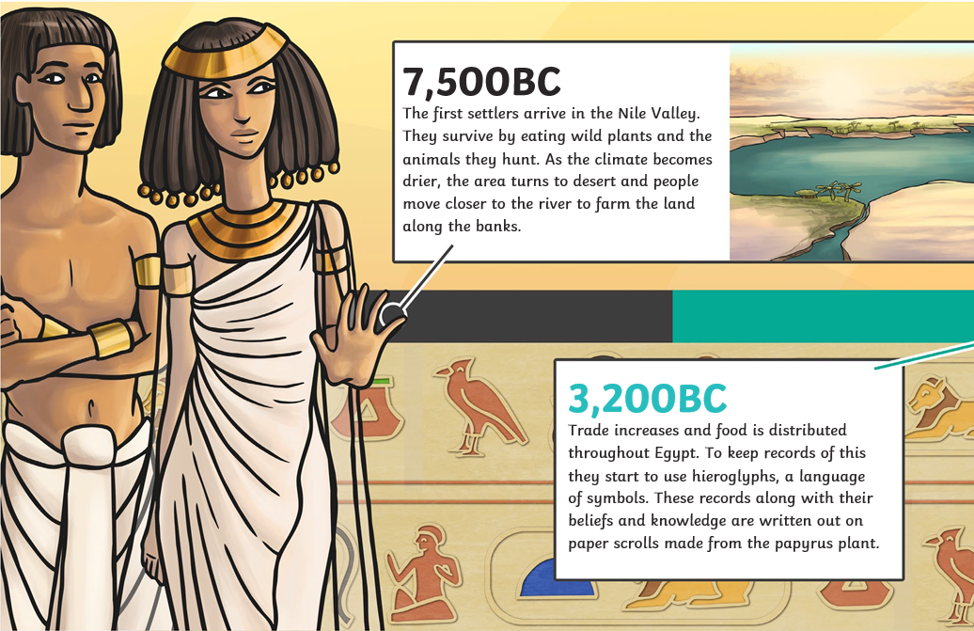
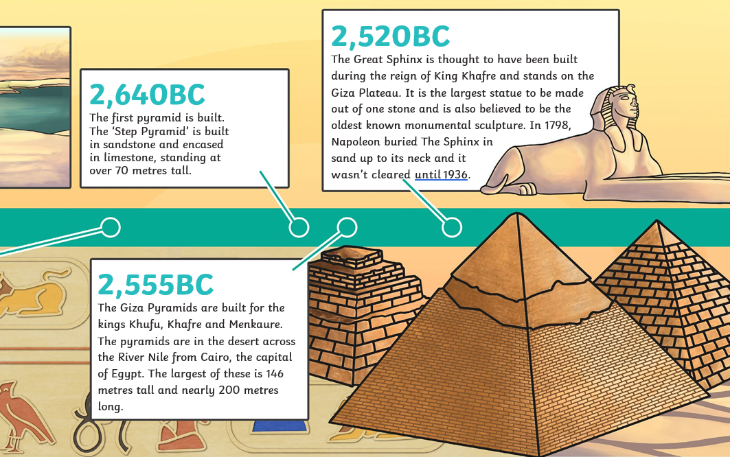
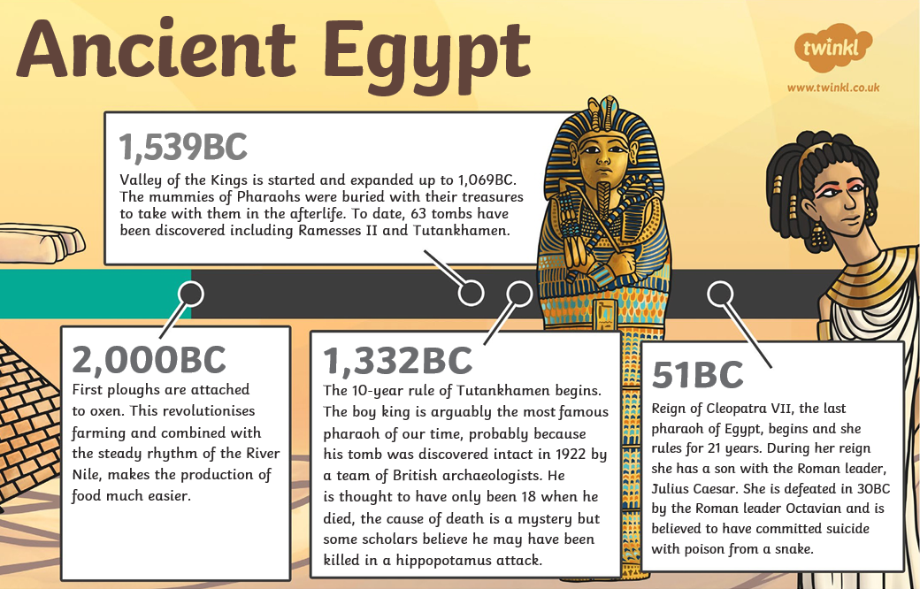
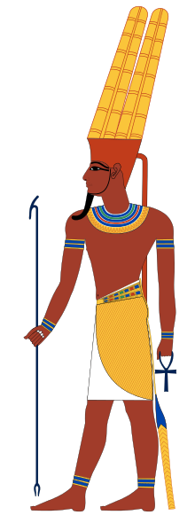
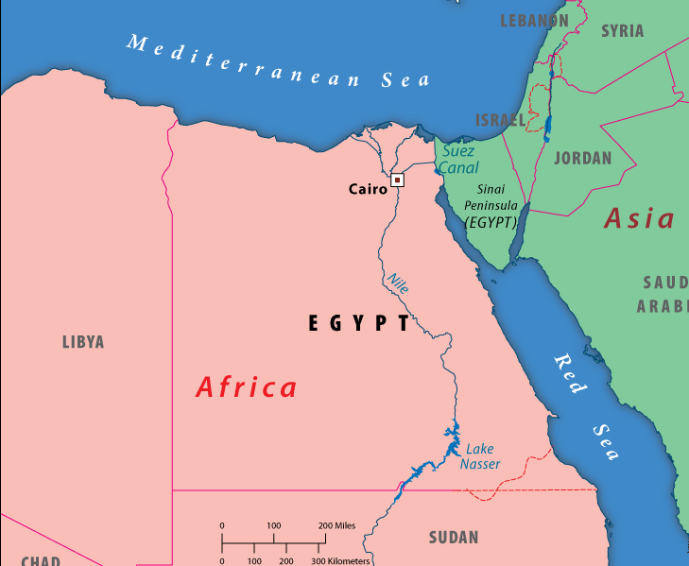
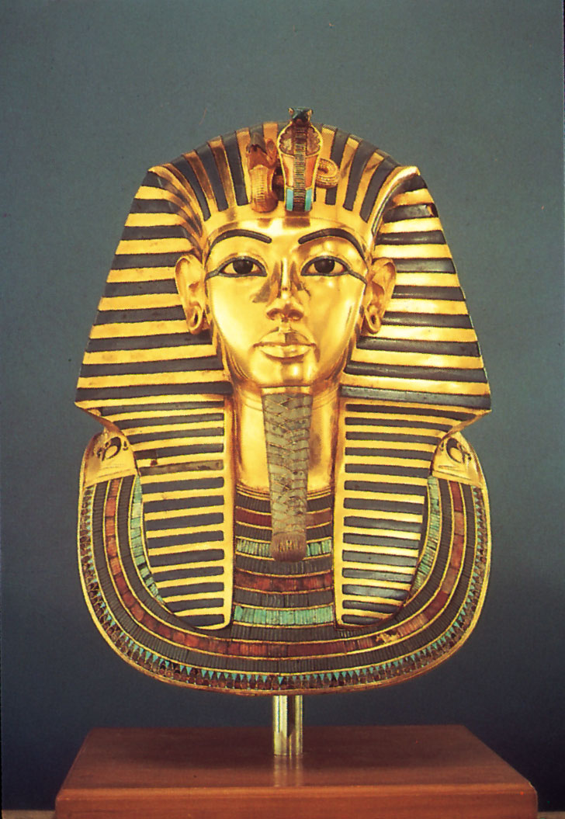
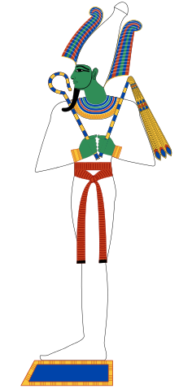
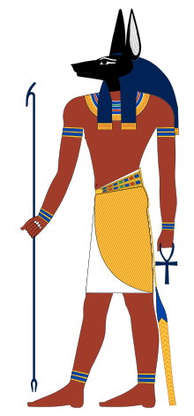
Egypt and The Nile
Tutankhamun
Amun, Osiris and Anubis – Egyptian Gods

