Slide 1
SCIENCE – Year 3
Knowledge organisers

Slide 2
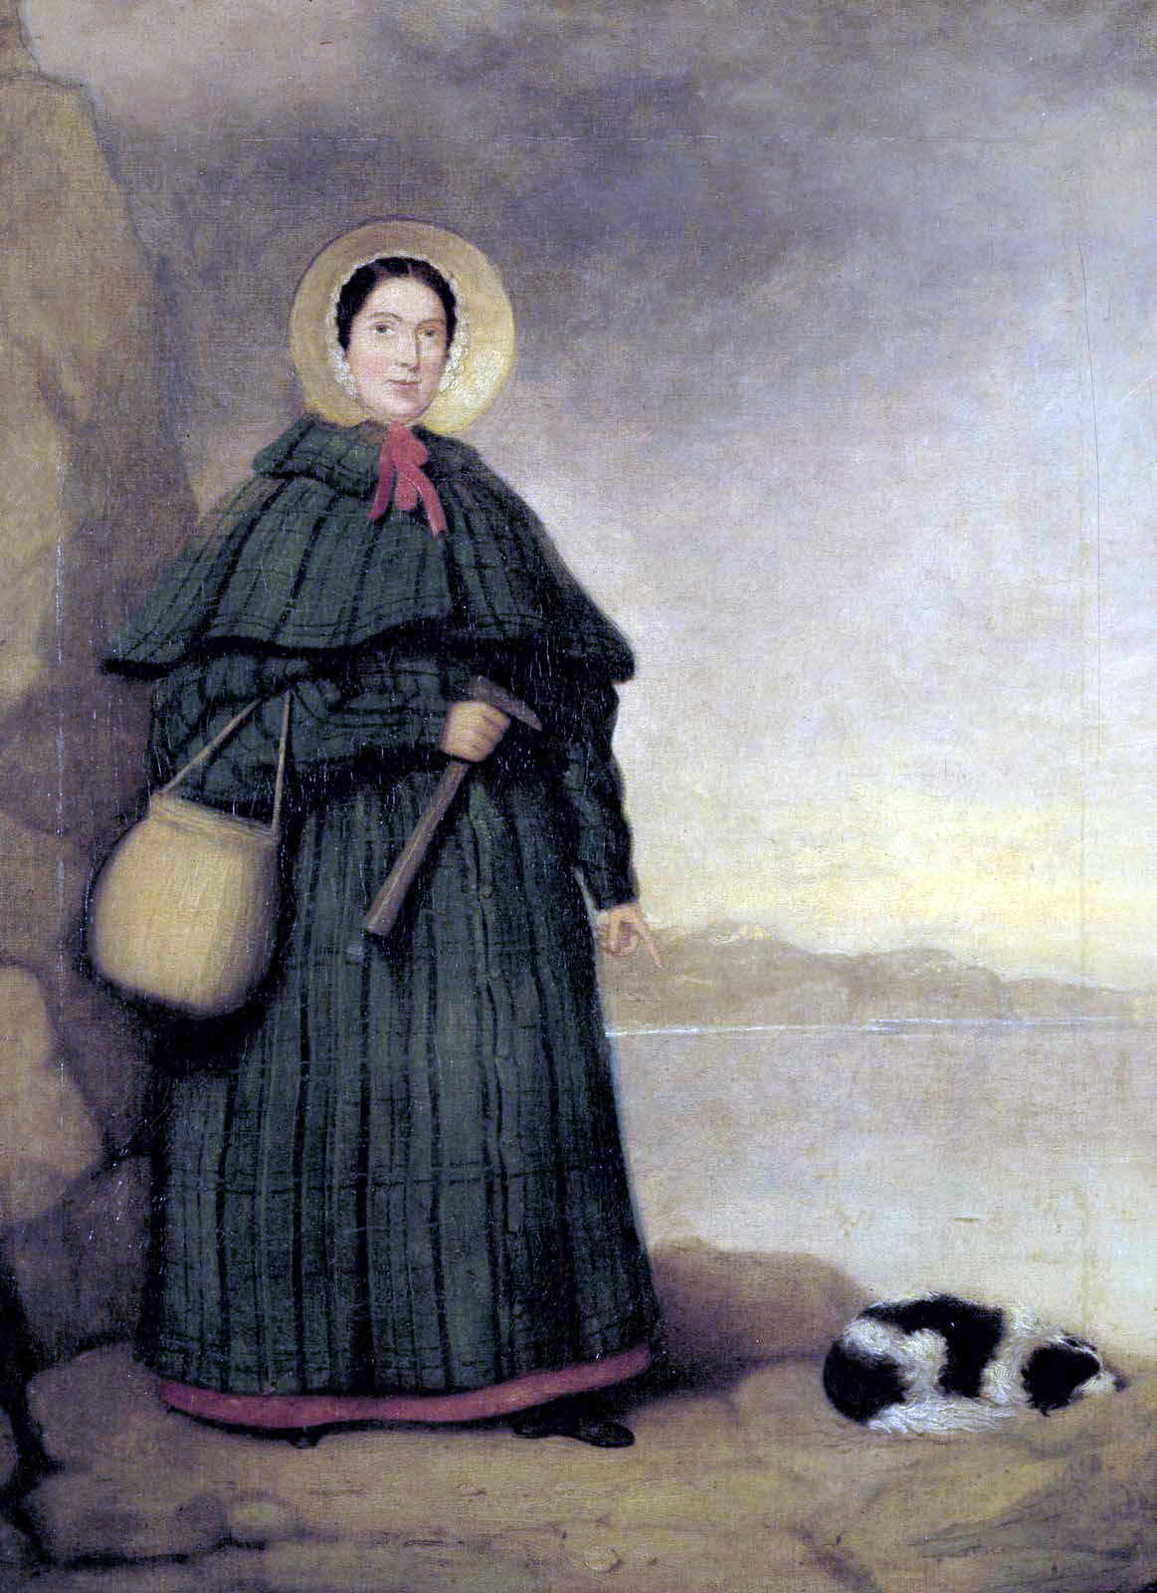
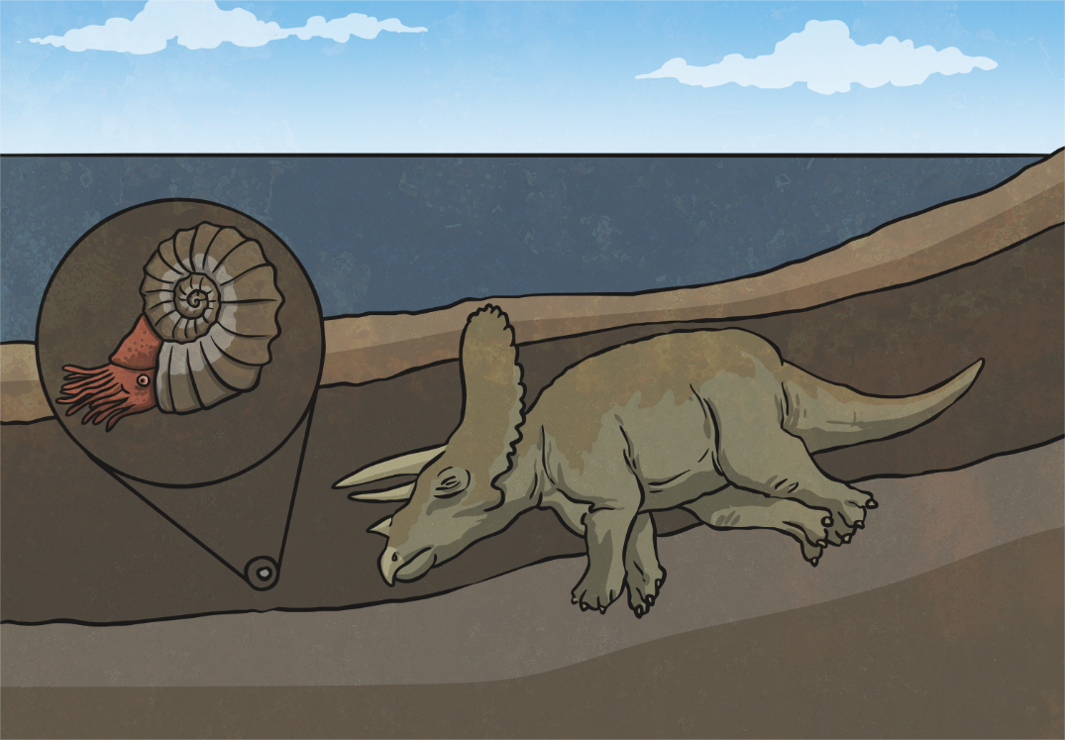
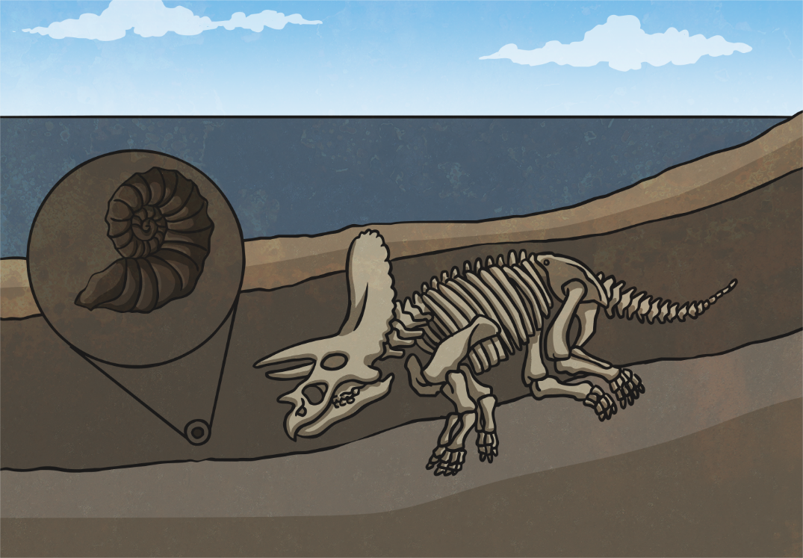
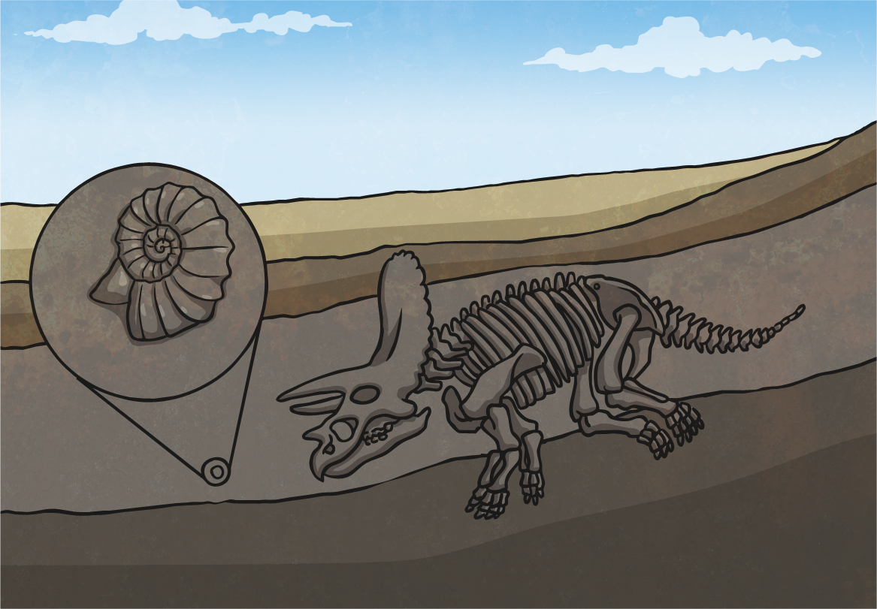
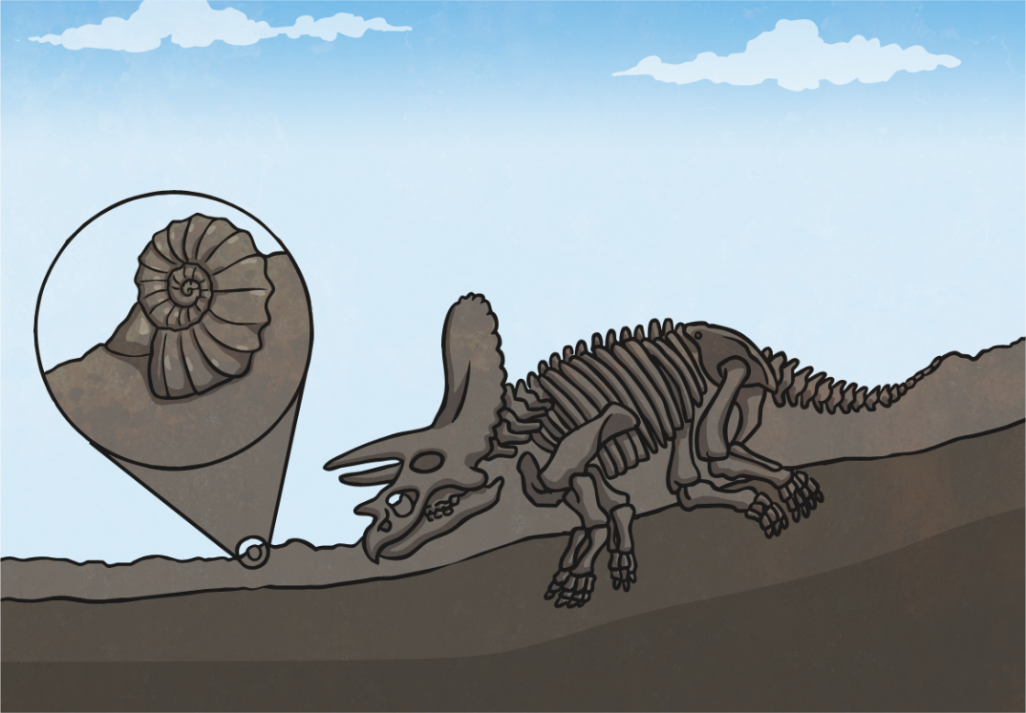
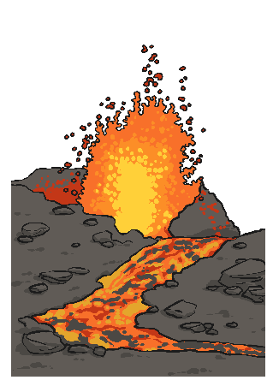
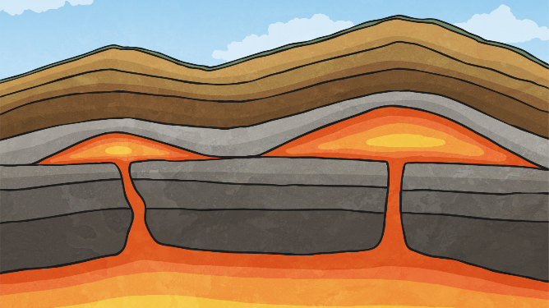
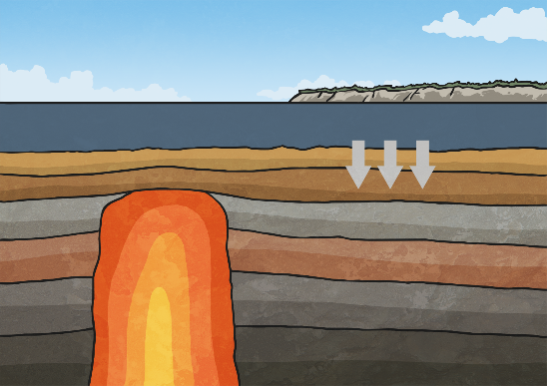
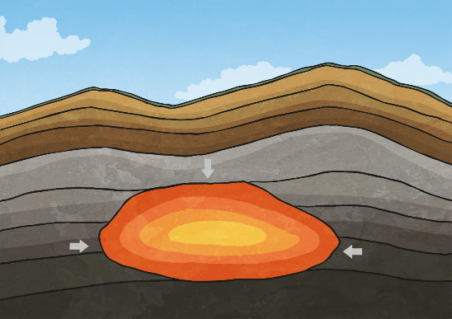
Year 3 Autumn Term 1
Rocks
Scientists Studied
Mary Anning
Key Vocabulary
Rocks
Igneous
Sedimentary
Metamorphic
Anthropic
Permeable
Impermeable
Fossil
Palaeontology
Amber
Organic matter
Topsoil
Subsoil
Base rock
Cliffs
Erosion
Magma
Lava
Molten
Natural
Man-made
Overview
The children will learn to name and identify the three types of rocks. They will handle and examine rocks to classify them according to their properties.
They will learn about the composition of soil, being able to state the four different types of matter that make up soil.
They will be able to identify the difference between a bone and a fossil.
They will learn about the process of fossilisation.
They will use their scientific skills to make and record observations over time.
Fossilisation
Key Questions
How are rocks formed?
Is concrete a rock?
How do we know what
dinosaurs looked like?
Where is the best place to
find a fossil? Why?
What is the difference
between magma and lava?
Rock Formation

Slide 3
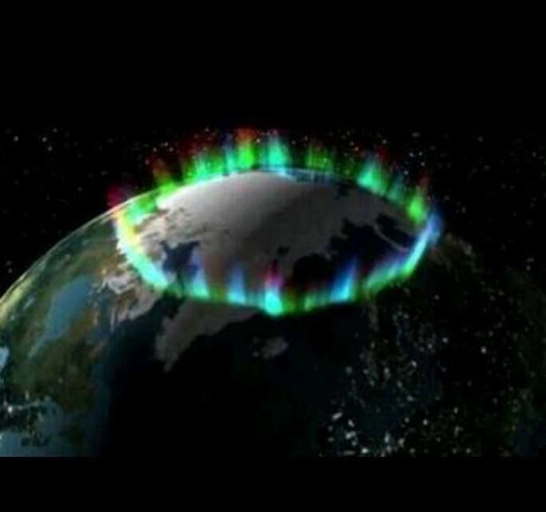
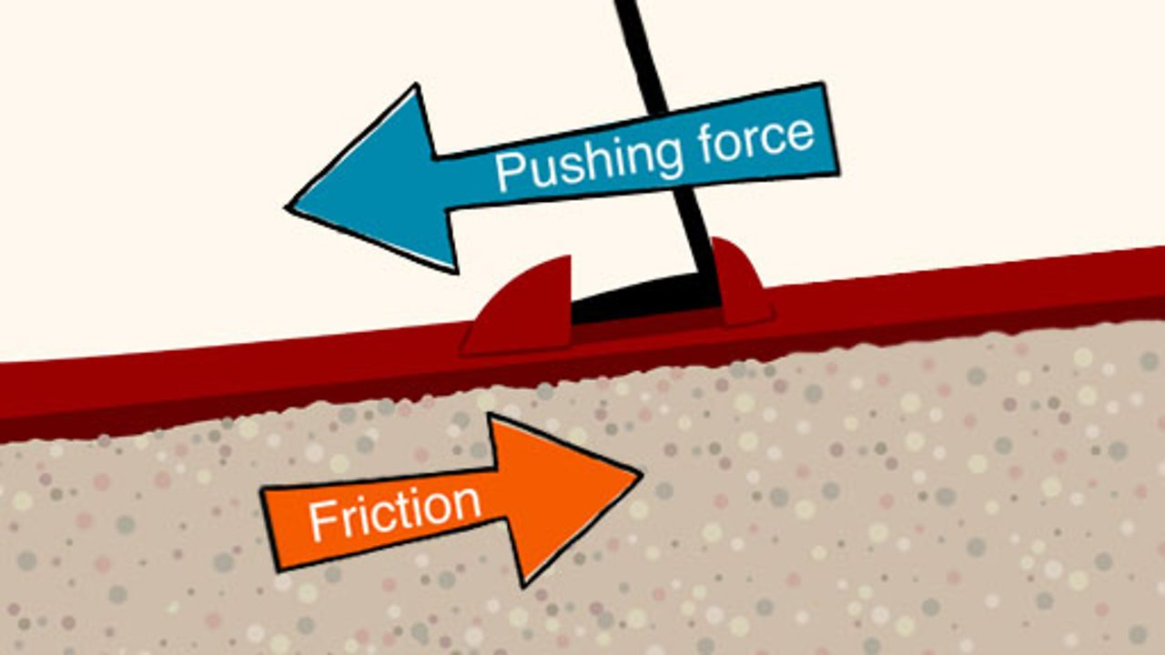
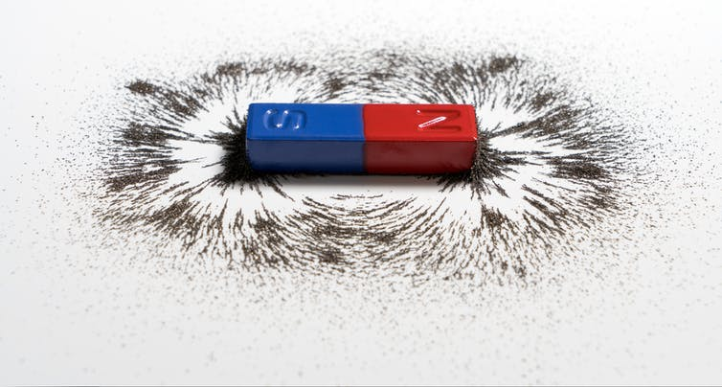
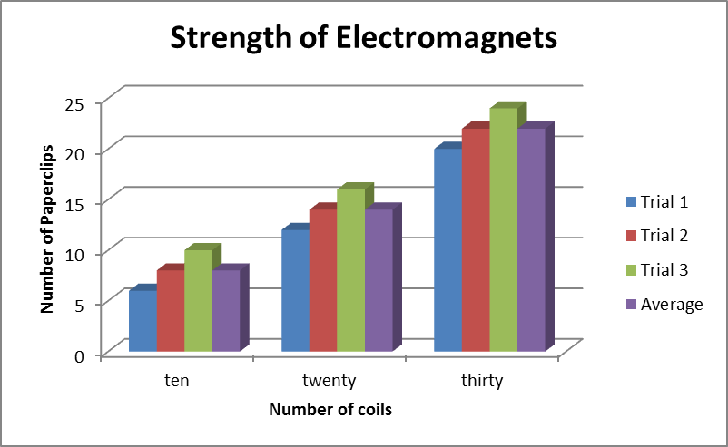
Year 3 Autumn Term 2 Forces and
Magnets
Key Vocabulary
Force
Push
Pull
Friction
Surface
Smooth
Magnet
Magnetic
Magnetic field
Pole
North
South
Attract
Repel
Compass
Northern Lights
Overview
The children will learn about forces as pushes and pulls. They will investigate friction practically and understand it as a force that slows objects down. They will investigate magnets in a variety of ways, including investigating magnet strength, poles and classification of magnetic and non-magnetic materials. They will look at the poles of magnets and investigate their influence on each other within a magnetic field. Finally, they will investigate the effects of magnetism in the real world, including researching the Northern Lights.
Key Questions
Can all forces be classified as pushes or pulls?
What’s the best material for slowing a car down?
Why is ice slippery?
What happens when magnets meet?
Are people magnetic?
Is the Earth magnetic?

Slide 4
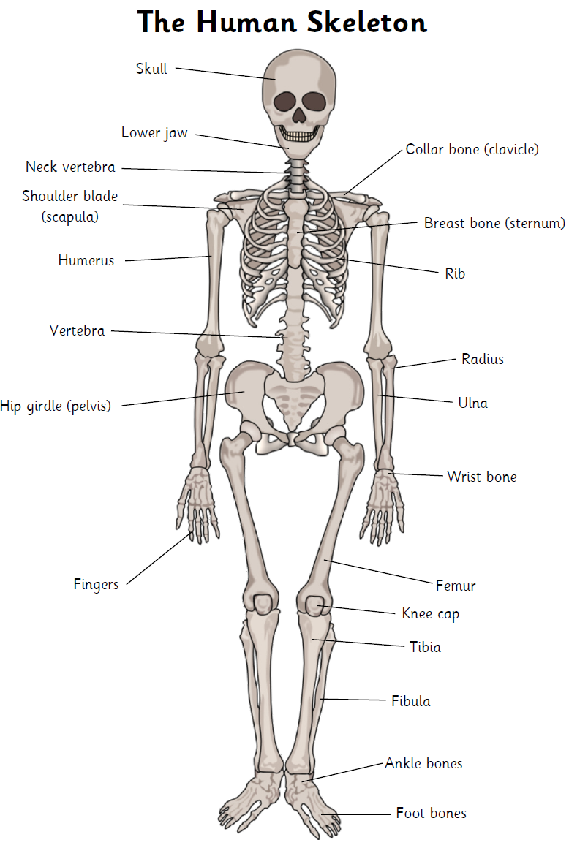
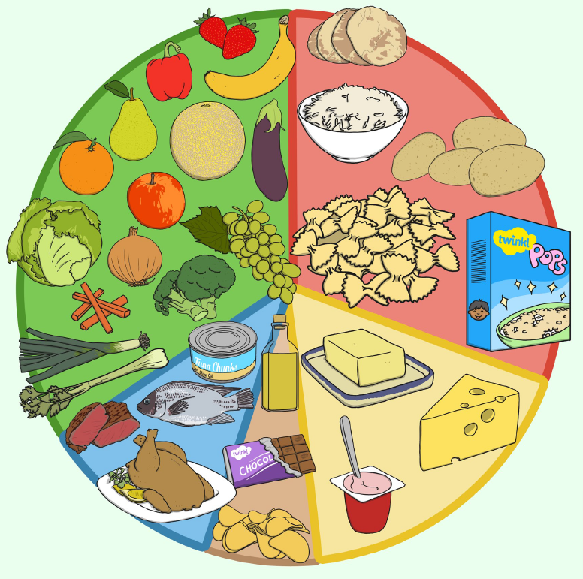
Year 3 Spring Term 1 Animals including
Humans
Key Vocabulary
Classify
Compare
Characteristics
Vertebrates
Invertebrates
Nutrients
Nutrition
Food groups
Carbohydrates
Protein
Fats
Minerals
Fibre
Skeleton
Endoskeleton
Exoskeleton
Hydrostatic
Bones
Joints
Muscles
Contract
Relax
Tendons
Overview
The children will learn that plants and animals obtain food in different ways. They will be able to identify the right types and show they understand the right amounts of nutrients required by animals including humans.
They will be able to name the different types of skeletons and categorise animals by skeleton type. They will be able to identify the main bones in the body and explain how a skeleton protects, supports and helps the body to move. Finally, they will be able to explain how pairs of muscles work together to enable movement.
Key Questions
What’s the different between how plants and animals obtain their food?
What would a balanced diet look like for humans?
Can we work out a balanced diet from real foods based on the food groups?
Does a skeleton have to be inside the body?
If I were to make a limb joint, what muscles would I need?

Slide 5
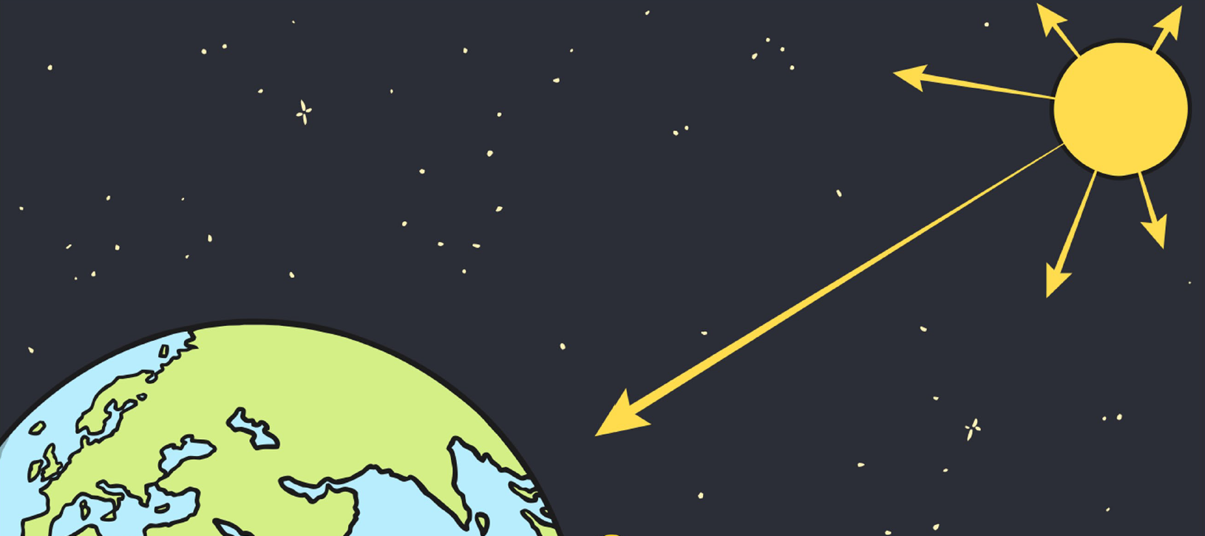
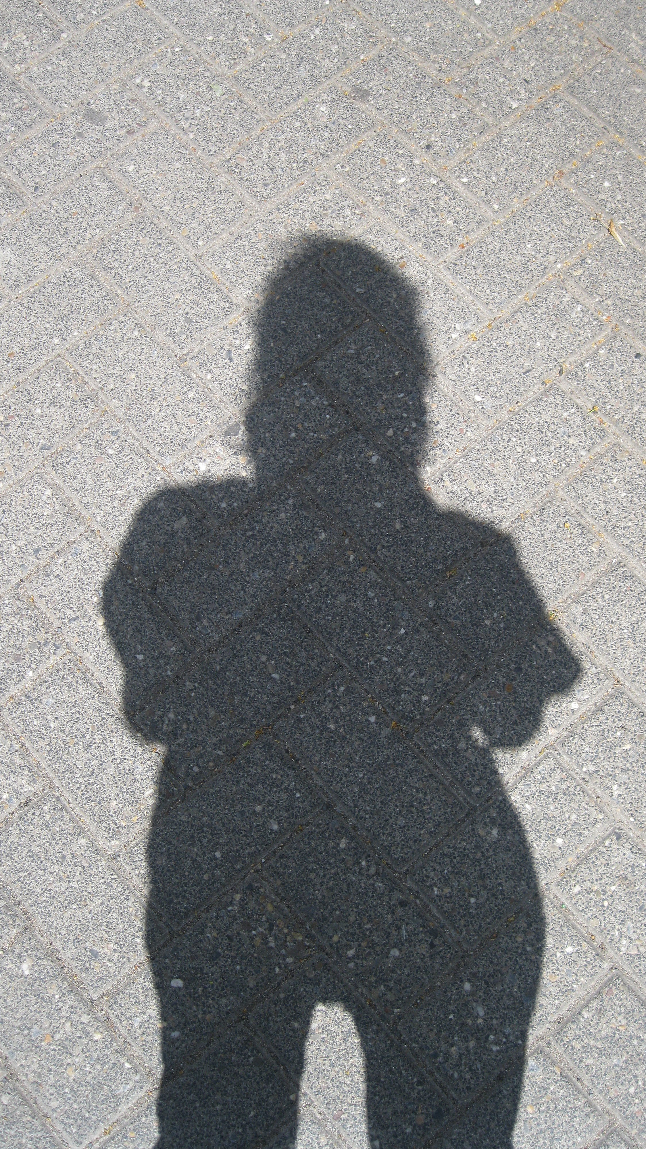
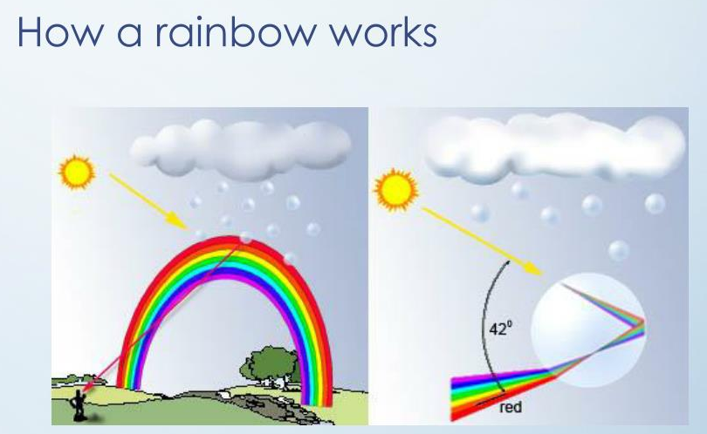
Year 3 Spring Term 2 Light
Key Vocabulary
Light
Source
Dark
Reflect
Visible
Bounce
Mirror
Ray
Beam
Sun
Glare
Pupil
Travel
Straight
Transparent
Translucent
Opaque
Block
Shadow
Material
Surface
Reverse
UV
Overview
The children will be able to identify and classify light sources.
They will understand that we need light to see and develop an understanding of how light reflects off surfaces differently.
They will understand why the image you see in a mirror is not quite all it seems as well as investigating mirror codes.
They will know that light travels in a straight line and how this affects shadows.
They will understand that a shadow is formed when light is blocked and they will investigate how blocking light can protect our eyes and skin from dangerous light, especially UV sunlight.
Key Questions
Why can’t we see round corners?
What is the reflective strip on our book bags for?
Can we predict how shadows might change throughout a day?
How can we protect ourselves from damaging sunlight?
How much damage can sunlight do anyway?
Is there gold at the end of a rainbow?

